Slide 1
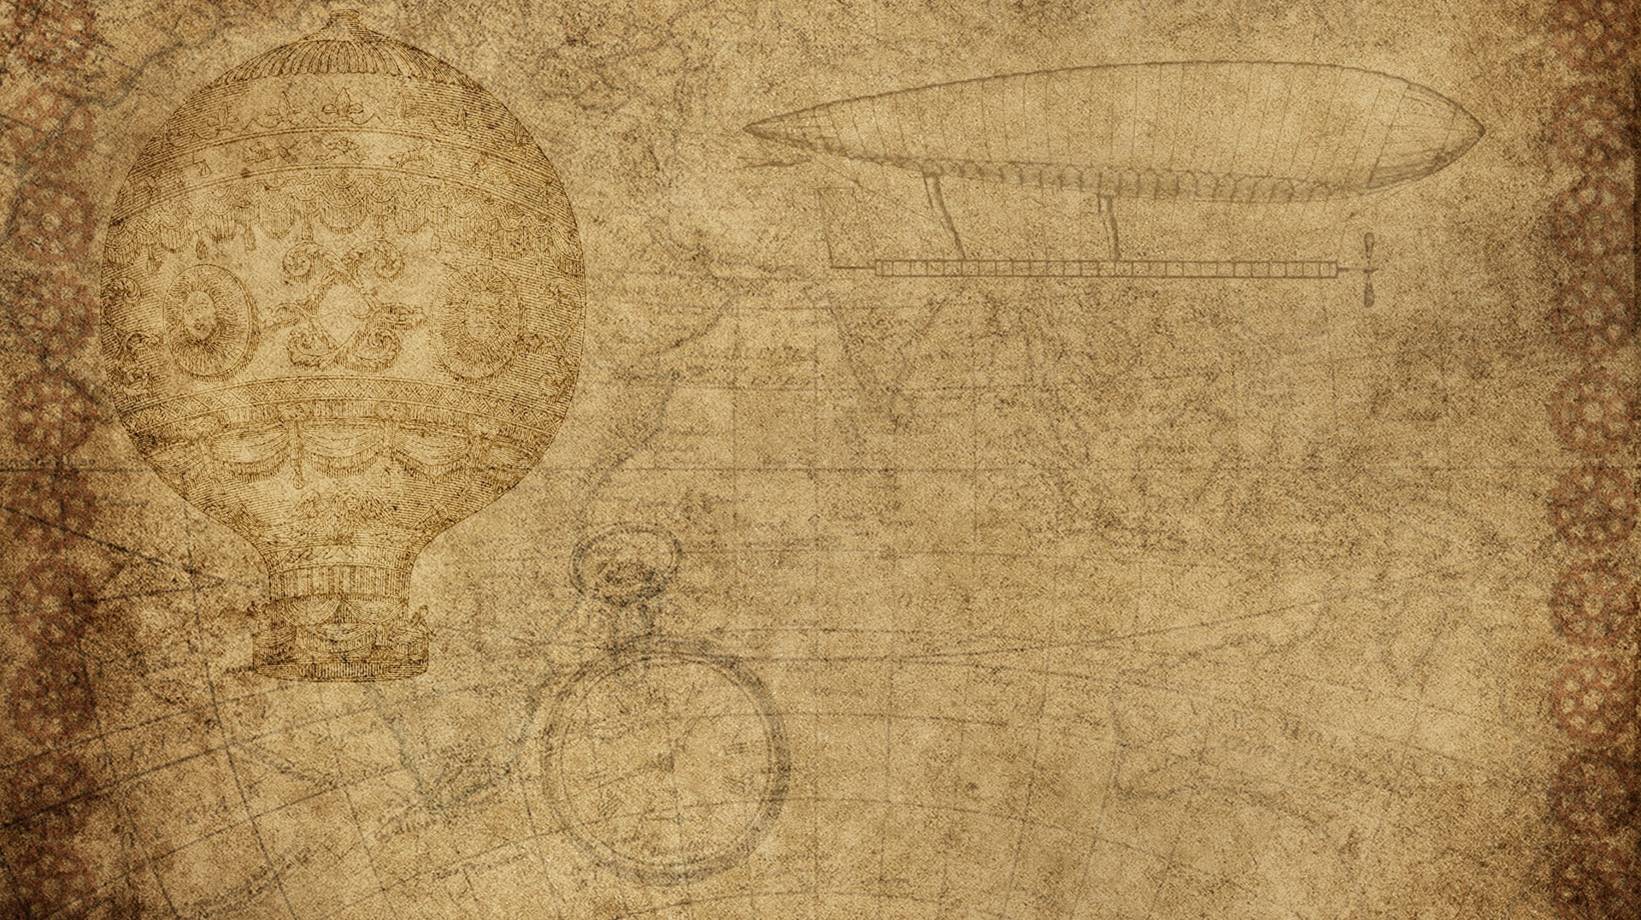

Physics Destroyer
Matthew Peace
Dustin Bramos
Steve Catherman
Steven Jazrawi
Chris Wiegand

Slide 2

Application Goal
Our goal is to create a physics calculator that will allow users to enter known variables and automatically solve all equations possible with those known variables.

Slide 3
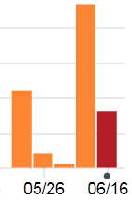
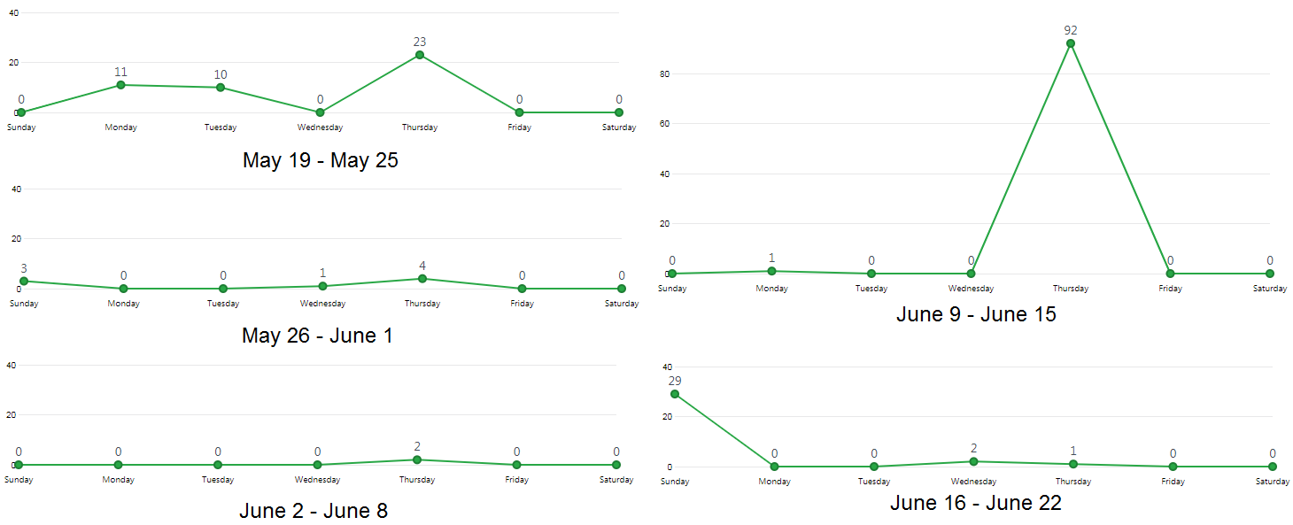
GitHub Commits

Slide 4
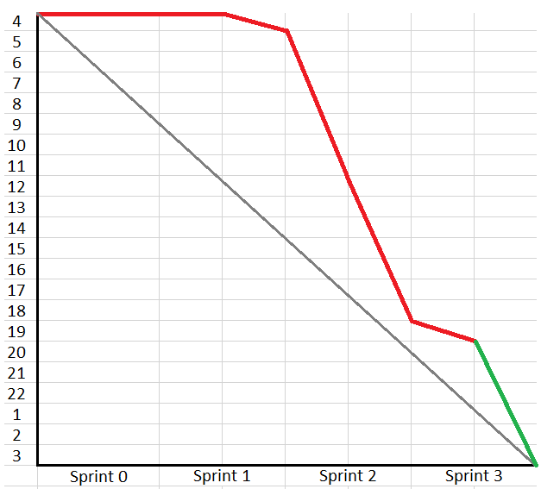

Burn Down
We were never actually this far behind, but we kept adding tasks, as we thought of new features or improvements, essentially moving the goal posts.

Slide 5

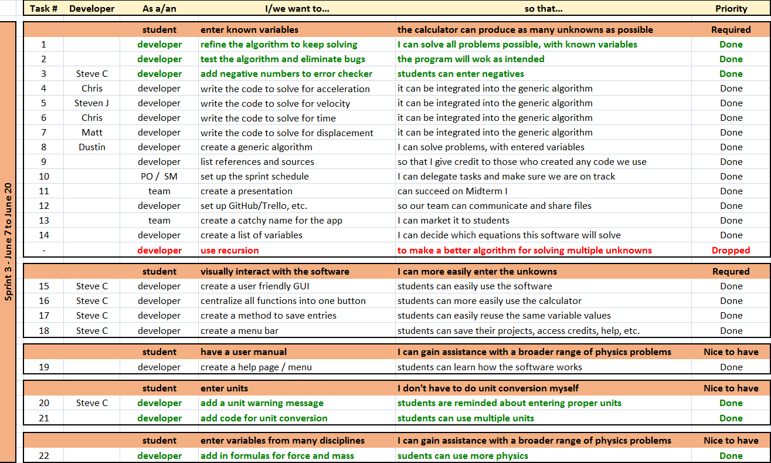
Product Backlog

Slide 6
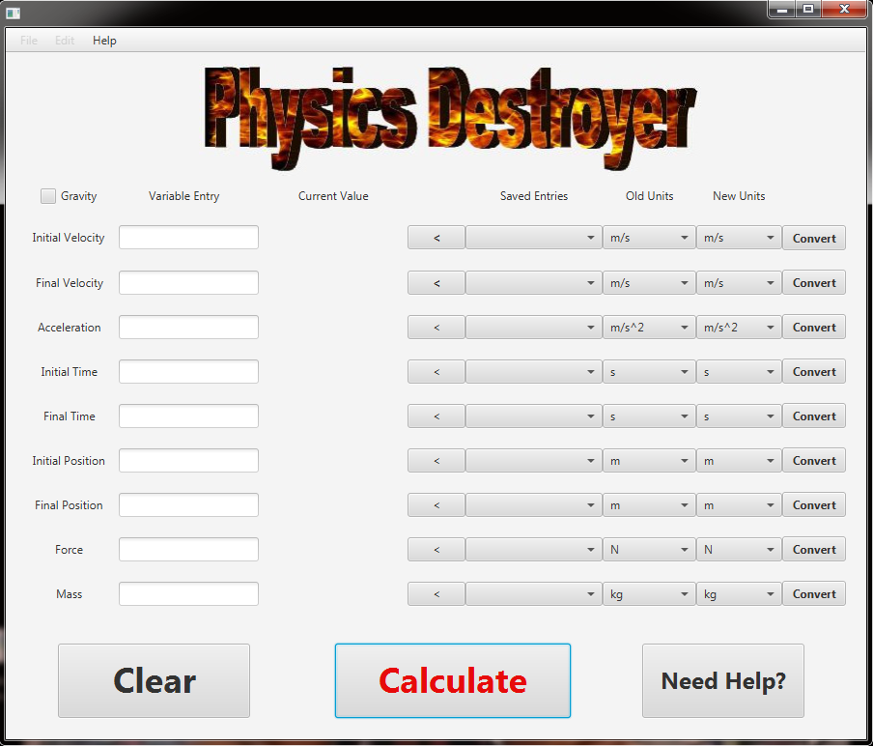
Final Look
Features:
Solves multiple equations
Saves old entries
Converts units
Error checks entries

Slide 7
Final Thoughts / Future Improvements
Add more variables and formulas
Expand into other branches of physics
Add more extensive unit conversion feature
Add ability to save old calculator sessions
Create web page / app for mobile use
Display equations used with variables entered
Add tabs for useful links to physics pages, etc.
Suggestions for missing variables, if it can’t solve with entries
Add “undo” or “back” button
Add sound and graphics
More ways to incorporate flames / explosions

